Slide 1
Fostering Communities of Practice in Data Management
Jon Wheeler jwhee01@unm.edu | Karl Benedict kbene@unm.edu

Slide 2

Workshop Series: Free & Open to All
Notes:
What would it take to get you or your faculty to a coding workshop? This really started out as asking ourselves, what would it take to get our colleagues from three other libraries to drop by for more info about RDS capabilities and services. Started as in-reach, and pretty successful at that – between April-July 2017 we piloted this program as a library workshop. Learned some things we’ll talk about later in terms of pacing, targeting a variety of skill levels, and exploring relevant use cases.
Many colleagues attended – the room got very warm sometimes. We decided to expand to the UNM community beginning August 2017. Community includes faculty, staff, students, and anyone in the local community as well. This presentation is focused on this second phase of C&C.

Slide 3
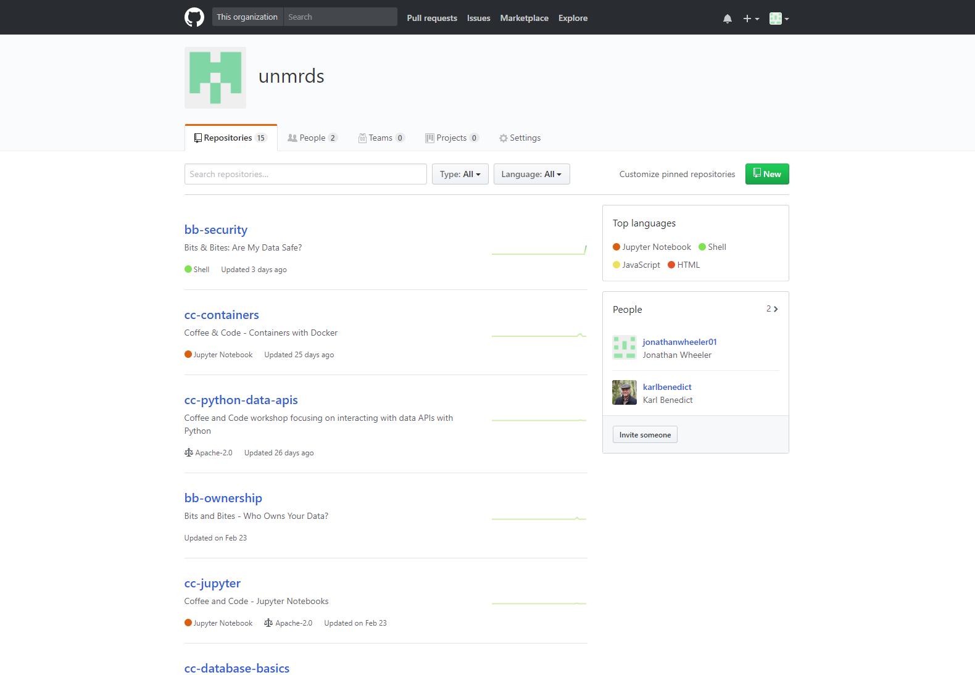
https://github.com/unmrds/
Notes:
For us it was a natural decision to quickly establish a public repository within which we would develop our content, and share the workshop materials with others. GitHub was a natural fit because we were already using Git (both GitHub and LoboGit – our locally hosted GitLab platform) for a number of other projects, and as a publicly accessible and well known platform we would have an opportunity to create a highly visible and open project for continued development of the workshop series content.
Anything with a cc- prefix is coffee and code content. There are some bb- prefixes as well – those include content for a second series called bits and bites we will talk about later.
Feel free to browse the sessions – we’re happy to answer questions about particular topics.

Slide 4
Workshop Topics to Date
Fall 2017 Series:
August 11 - Working with the Command Line
September 8 - Programming Concepts Demonstrated with Python
October 13 - Jupyter Notebooks for Data Analysis and Visualization
November 10 - Write Once and Use Everywhere with Markdown and Pandoc
December 8 - Version Control with Git, GitHub and LoboGit
Spring 2018 Series:
February 9 - Database Basics
March 9 - Containerization with Docker
April 20 - Qualitative Analysis with NVIVO (Guest Presenter)
May 11 - Interacting with Data APIs Using Python (Guest Presenter)
Notes:
The series has definitely started as an opinionated set of workshops that present topics that we both have experience with, AND feel are technical areas in which diverse researchers can benefit from some level of familiarity with. As we have interacted with researchers we have continued to expand the list of topics.
Topics build off of each other, but can also stand alone – as we present we do maintain a bigger picture focus that ties concepts from various sessions in with more general issues of research and data management.
Anyone familiar with Data and or Software Carpentry may recognize some of these topics. To date we have preferred to develop our own content, though we are aware of the Carpentry series among others. As we’ve gone along, however, we’ve benefitted from the flexibility that a smaller, localized focus provides. That is, we’re able to plan sessions around more particular or in depth topics that align with our interests and the interests of our colleagues, as well as which highlight particular data management issues and any corresponding services we provide. Examples from the past year include Jupyter notebooks, Markdown and Pandoc, and containerization. We look forward to having follow up sessions as well – getting into more advanced topics around version control, database design and Python in particular. There is a lot of interest in these particular technologies.

Slide 5
Drivers
Notes:
Why did we do this? As noted, originally the main driver was in-reach, creating opportunities to see our library colleagues and share info about our ongoing work and capabilities within Research Data Services. But as we developed that initial series and expanded it, we were motivated by other factors.

Slide 6
Motivators: Models & Positioning
 | Carpentries | Data Management Curricula | Librarian Skill & Professional Development
Programs | Software Carpentry Data Carpentry Library Carpentry | DataONE Education New England Collaborative Data Management Curriculum Research Data MANTRA | MANTRA DIY Research Data Management Training Kit for Librarians
Example Concepts & Skills | Tabular data management & analysis (OpenRefine, SQL, R) Version control Programming | Data management plans & planning Metadata & data documentation Spreadsheet best practices Data security File management | Research data management concepts Data archiving & preservation Data literacy
Notes:
Conceptual drivers represent current practice and models in data management and research training, nationally and internationally.
We have some experience with the Carpentries – both completed Data C. UNM hosted Software C. We know there is interest among our colleagues for Library C. We really like the range of topics covered by the Carpentries, and the emphasis on hands on activities and the types of community support that take place within the Carpentry context. We very much wanted that hands on, open and collaborative context.
Many data management best practices and concepts are included in the Carpentries, but planning for C&C we wanted to highlight these concepts more and present the content with concrete use cases relevant to data management. In this aspect, we look to a variety of DM curricula that have been published by … This allows us to build a data lifecycle perspective into the sessions. It also provides a means to contextualize some of the issues that participants bring up – we have had discussions at C&C sessions about everything in the skills and concepts section (under data management curricula). The standard C&C format of conceptual overview followed by hands on activities is a way we bridge the Carpentry with the Data Management Curriculum models.
As noted, the series began as a way to reach out to our library colleagues and have fun with data management and applied technologies. The Carpentries and Curriculum are certainly relevant to them as well as other researchers, but especially for our initial set of workshops drivers included the resources referenced here. We note much overlap across all of these models.

Slide 7
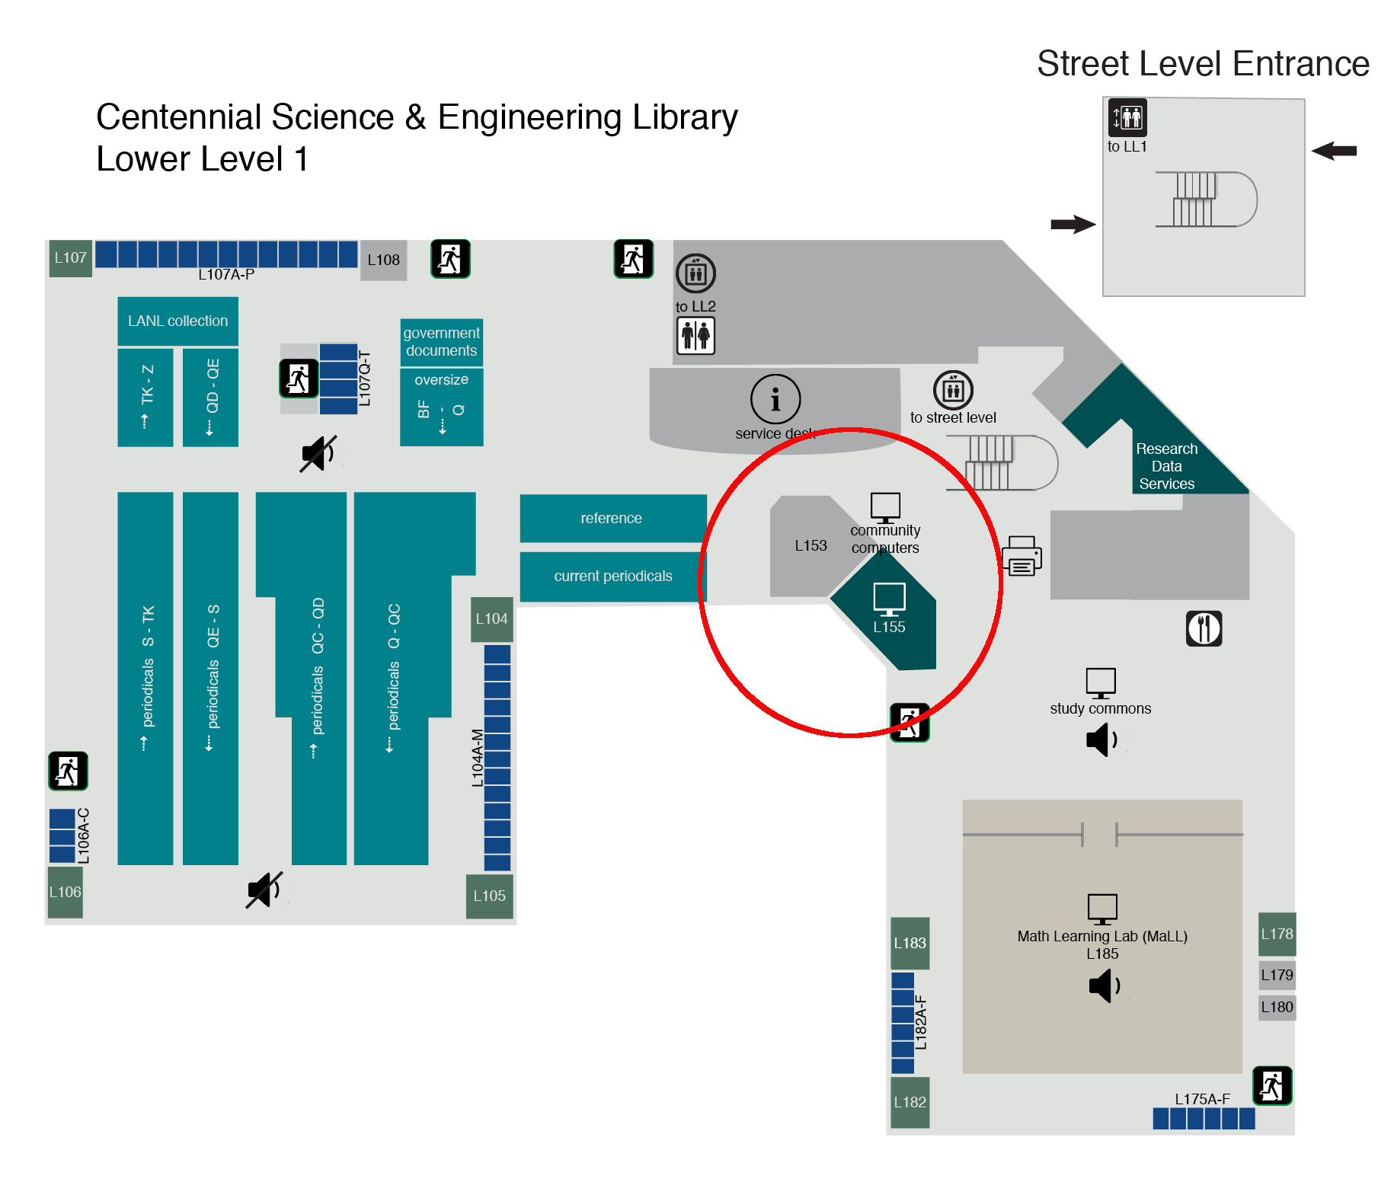
Motivators: Space & Culture
Notes:
From a conceptual standpoint, the models and motivations described are enough to launch a program. But am important part of the story is space. We had an opportunity in 2016-2017 to upgrade some space in the library
Four libraries on main campus, CSEL is the science and engineering library. Given the capabilities, what could we do to
Support the specific needs of science and engineering students
Establish CSEL as a hub of data management instruction and data literacy
Keep things fun and flexible

Slide 8
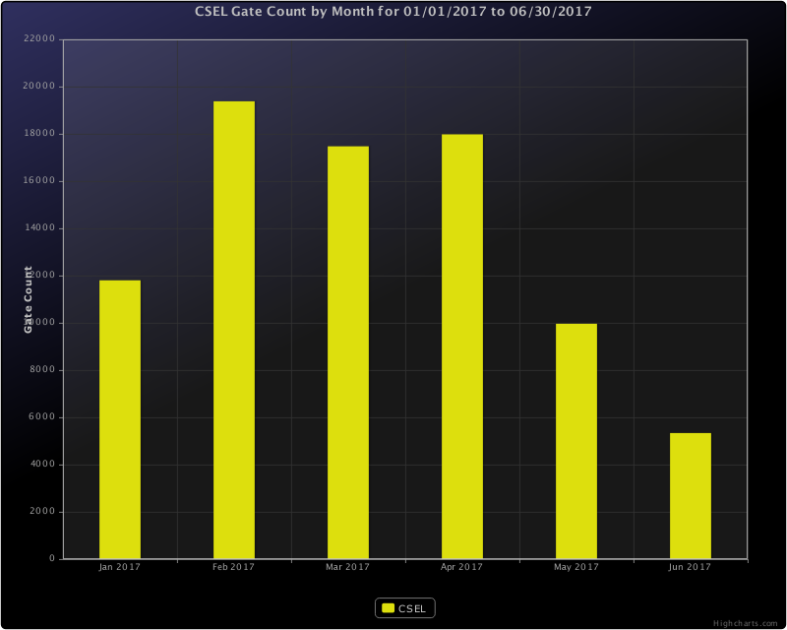
Notes:
And we have a population to serve and who view CSEL as their home or main library resource – as an overview, stats from spring 2017, when C&C was being presented primarily to librarians.
Well trafficked space.

Slide 9
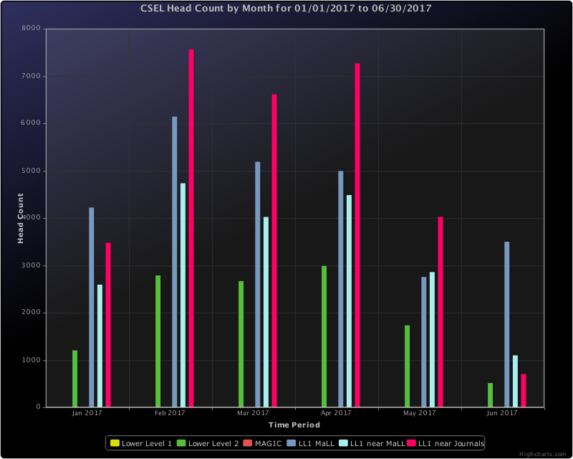
Notes:
A little more perspective – we have a Math Mall that provides math instruction support and testing for all UNM students. And the Mall definitely drives some of the traffic we see, but as evident here the majority of our patrons are not coming for the Mall, or at least not only for the Mall.
Not to dwell on this – naturally the stats are part of a bigger picture than C&C. But the library is well used and these numbers suggest that a public, open event in a highly visible location within the library would support our goals to cement that data management and data literacy identity at CSEL. Note from before the space is directly across from the service desk, next to the LL1 “near journals” area (bright pink) where head counts indicate a large number of students hang out.

Slide 10
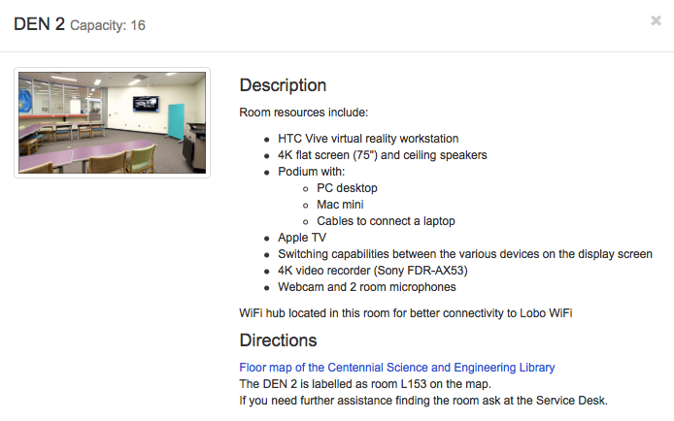
Motivators: Space & Culture
Notes:
And this is the space. Note capacity = 16.

Slide 11
Session Planning & Architecture

Slide 12
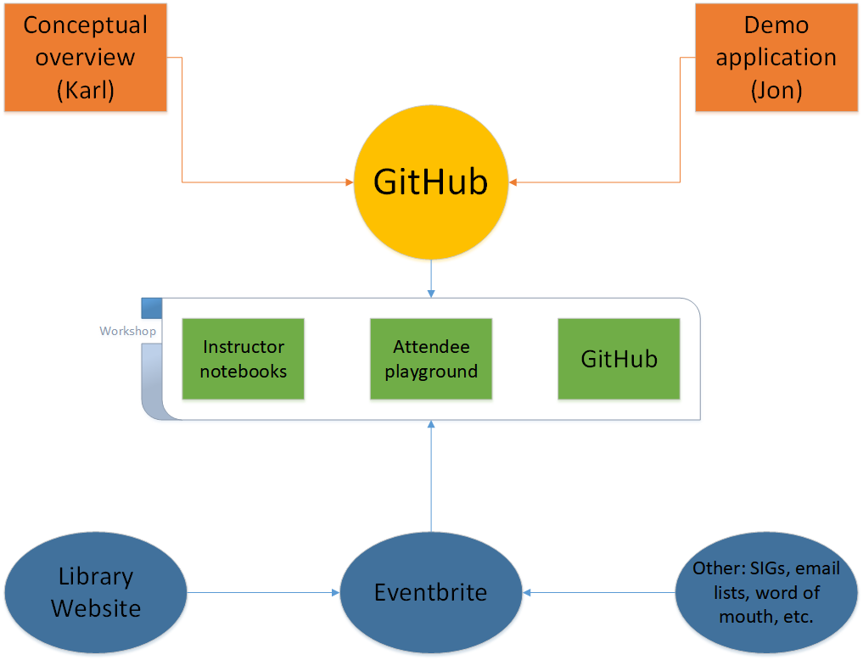









Anatomy of a Session
GitHub
Markdown

Slide 13
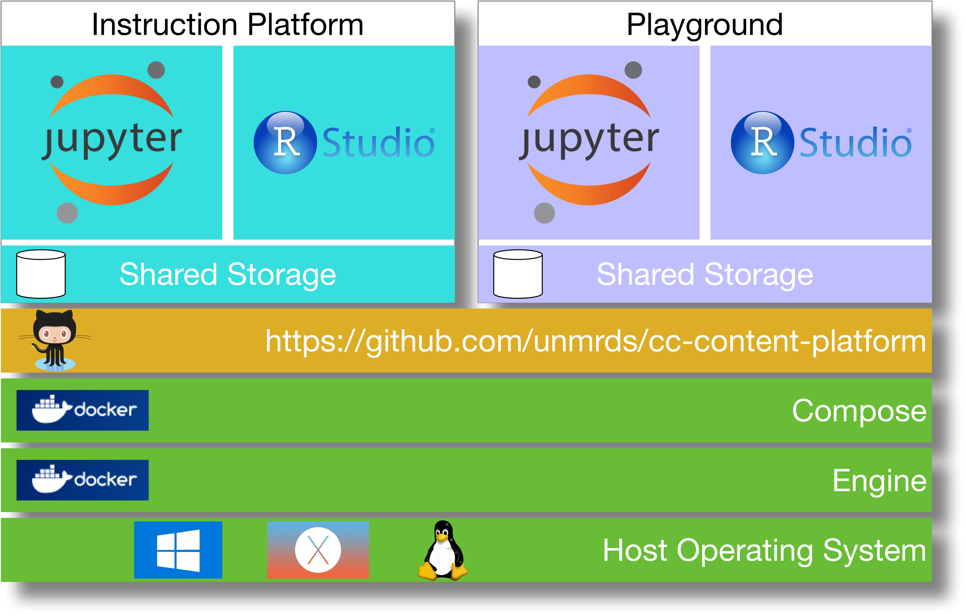
Instruction Platform

Slide 14
Outcomes & Lessons Learned

Slide 15
Managing a Monthly Series in Practice
PROS | CONS
Interest grows over time | Registration doesn’t guarantee attendance
Word of mouth supplements other communication strategies | Seating and space limitations require limiting registrations: “Sold out” doesn’t necessarily mean a full house
Engaged, returning participants promotes collaborative session and series development | Adapting content to participant skill levels and use cases can be a challenge
Broad community participation and outreach opportunities | Program development versus research
Notes:
The big idea here is that the pros and cons result from making C&C a regularly scheduled, monthly workshop. The good outcomes are better than we get for one-off or theme-week (OA Week, for example), but the cons amount to some admin overhead.

Slide 16
Growing a Community of Practice
Broad range of participants
High school students
Undergraduate and graduate students
UNM research faculty and staff
UNM IT staff and interest groups
Research support office
Library colleagues
Many use cases
Departmental and University IT version control
Text and qualitative analysis
Data documentation, sharing, and archiving
Research compliance
Replicability and reproducibility
Grassroots advocacy for lifecycle oriented research data management

Slide 17
Growing Content Collection
Developed
Planned/Envisioned
Introductory Sessions
Command Line Basics
Introduction to Programming Concepts with Python
Document Production with Markdown and Pandoc
Version Control with Git and GitHub
Database Basics
Jupyter Notebooks
Containerization with Docker
Qualitative Analysis with NVIVO (collaborator – scheduled)
Intermediate Sessions
Interaction with Data APIs Using Python (collaborator – scheduled)
Introductory Sessions
Introduction to R, RStudio, and R in Jupyter Notebooks
OpenRefine for Data Cleaning and Restructuring
Geospatial Data Management, Analysis, and Visualization with Open Source GIS (QGIS)
Intermediate Sessions
Managing and Analyzing Tabular Data in Python Using Pandas and Other Tools
https://github.com/unmrds

Slide 18
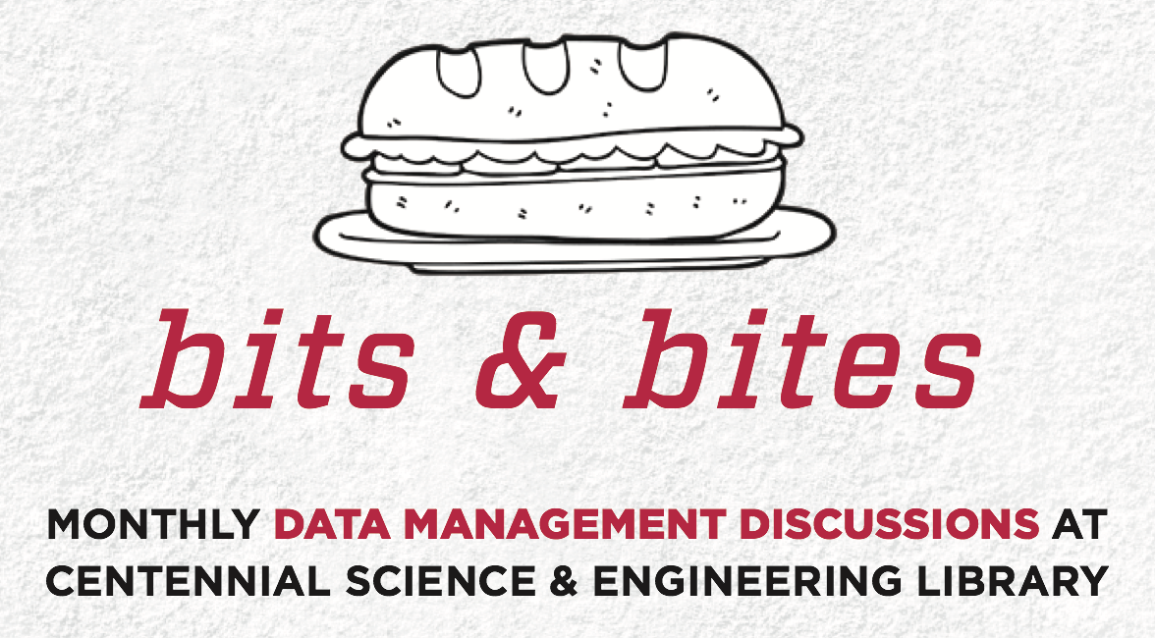
Follow-on Activities
Notes:
Who owns my data?
Are my data safe?
Where can I get and share data?

Slide 19

Next Steps
iStockPhoto

Slide 20

Expanding our Network of "Guest" Presenters
https://www.flickr.com/photos/87328375@N06/ CC-BY 2.0 https://flic.kr/p/dm1oxr

Slide 21
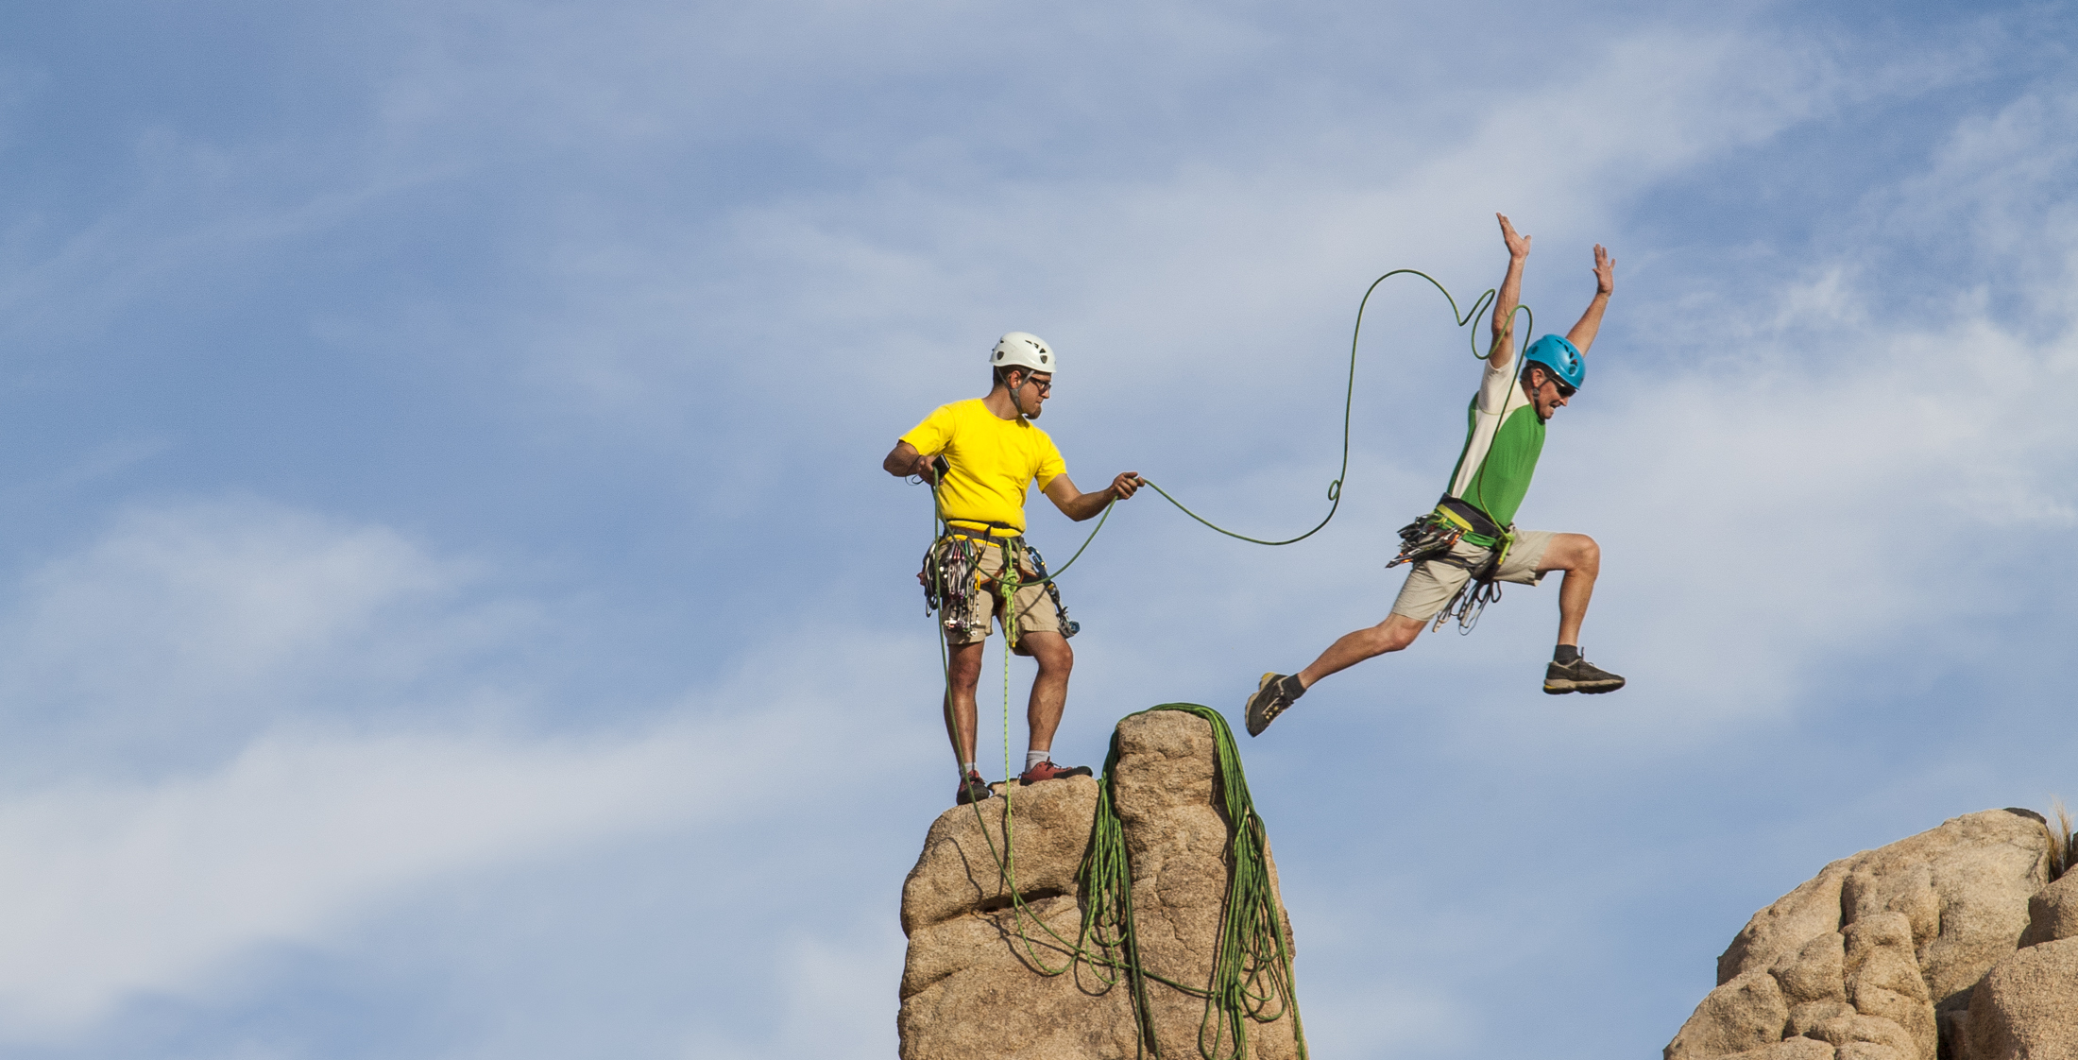
Diving More Deeply
Shutterstock

Slide 22
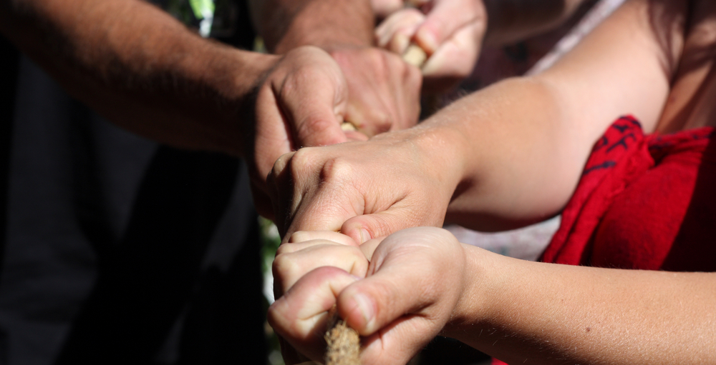
Collaborative Development of Current and New Content
Shutterstock

Slide 23

Questions & Discussion
iStockPhoto
Jwheel01@unm.edu <> https://github.com/unmrds/ <> kbene@unm.edu

